Slide 1
To replace with my own drawing

Slide 2
CSS143 Computer Programming (II)

Slide 3
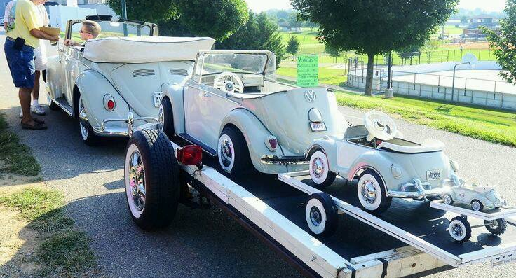
Recursion

Slide 4
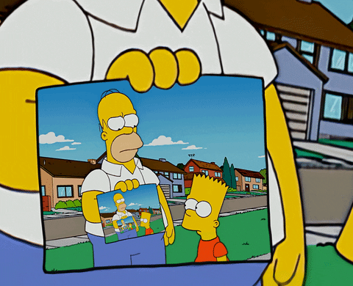
Recursion
A function that calls itself
void callMeMaybe() {
printf(“Hello Maybe!”);
callMeMaybe();
}
Not specific to Java

Slide 5
Why Recursion?
Problem using as complex data structure
Problems of recurring nature

Slide 6

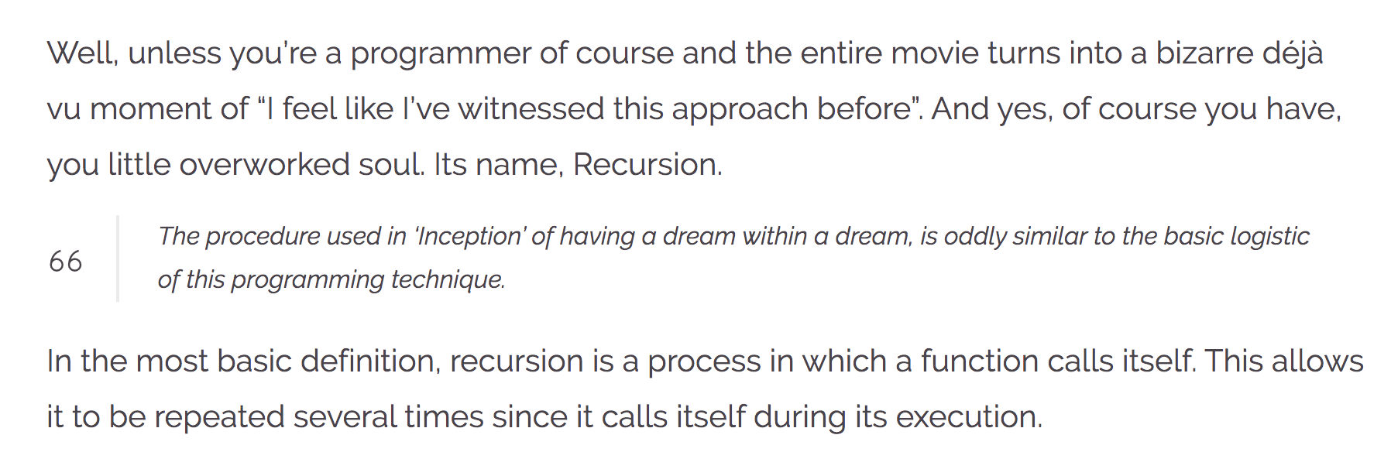
Recursion
https://wewrite.taleas.io/2018/11/14/why-inception-reminds-us-of-recursion/

Slide 7
Recursion

Slide 8
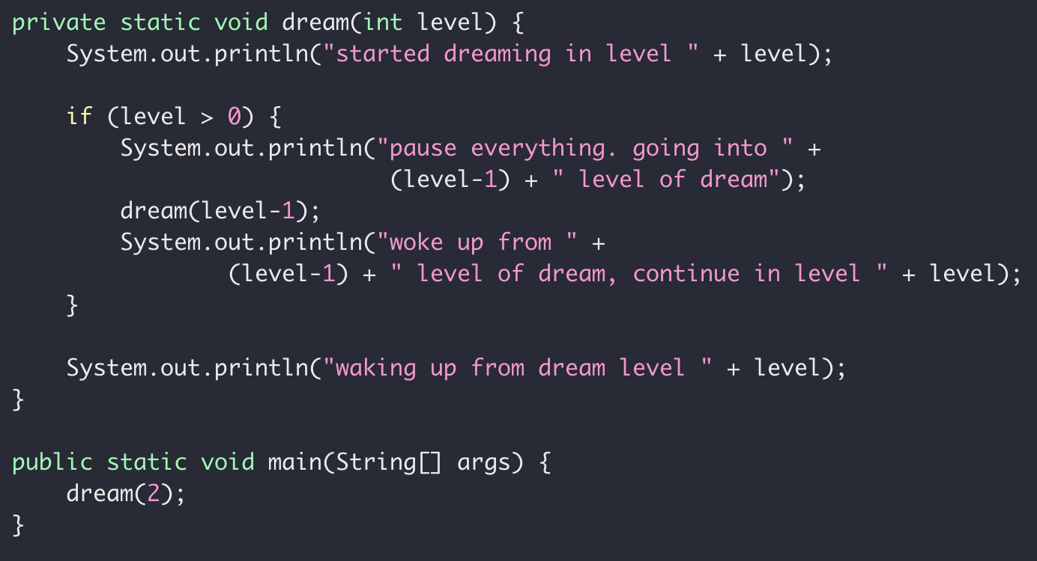
Dream in Recursion

Slide 9
Dream in Dream
Level 2
Level 1
Level 0
Time

Slide 10
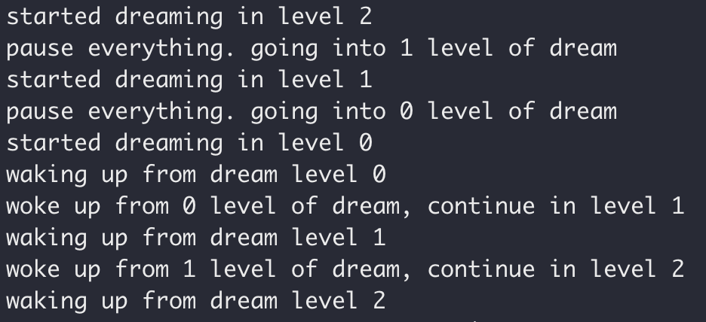
Dream in Recursion

Slide 11
Dream in Recursion

Slide 12
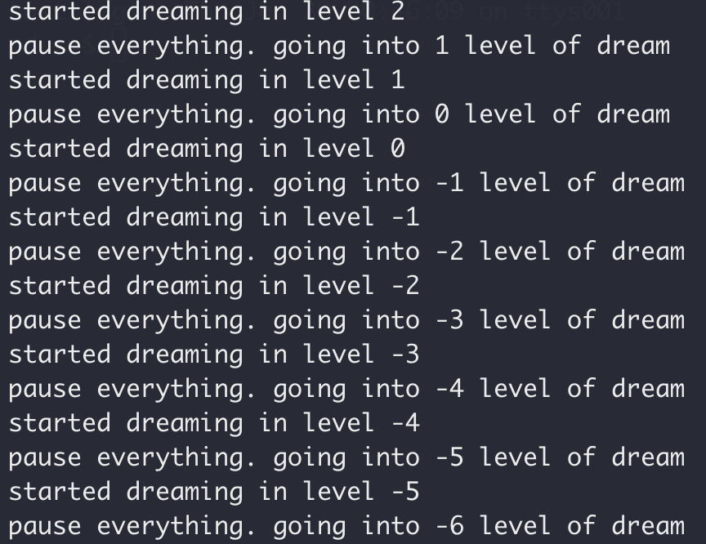
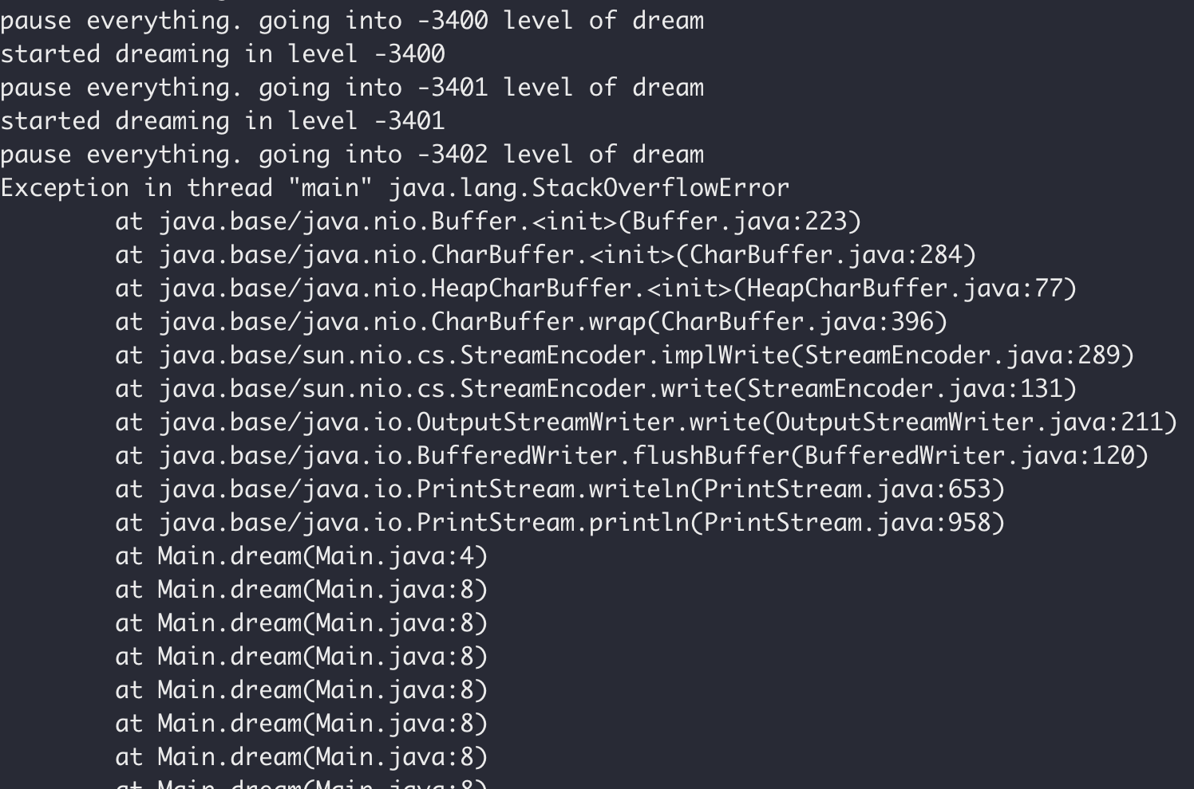
Dream in Recursion

Slide 13
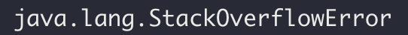
Dream in Recursion

Slide 14
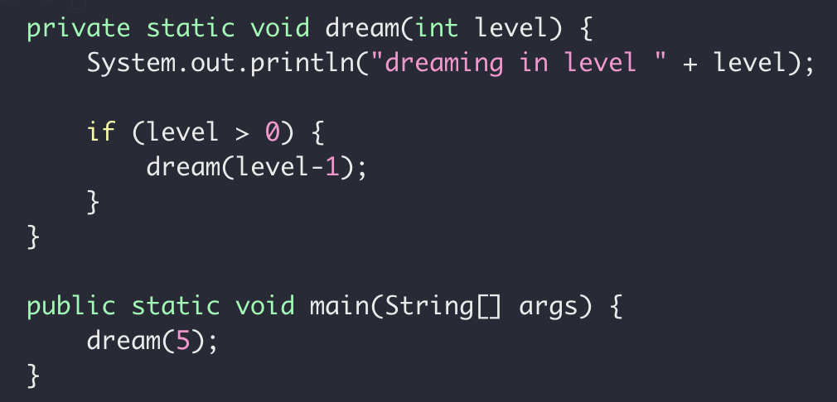
Recursion
Exit Condition
When the subproblem is ”small enough”
Stop recursion
solved directly

Slide 15
Recursion
How it works
When to use it

Slide 16
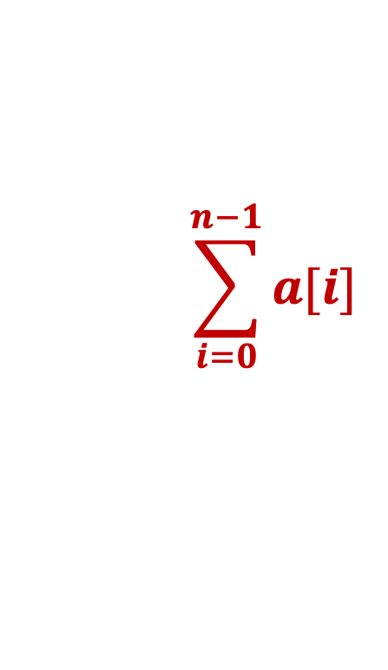
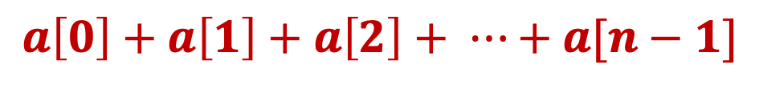
Recursive Sum
Write a function to get the sum of an integer array
$$a\left[0\right]+a\left[1\right]+a\left[2\right]+ ⋯+a[n−1]$$
$$\sum_{i=0}^{n−1}{a[i]}$$

Slide 17
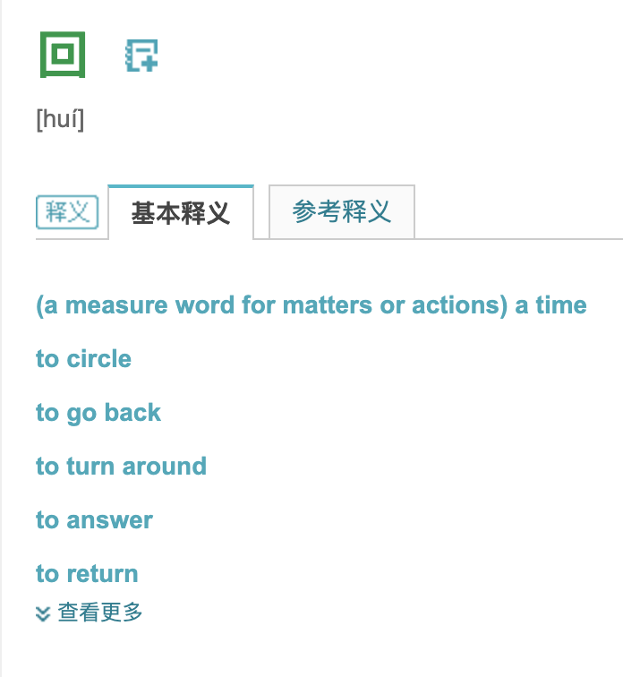
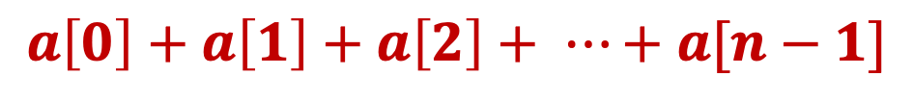
Recursive Sum
$$a\left[0\right]+a\left[1\right]+a\left[2\right]+ ⋯+a[n−1]$$

Slide 18
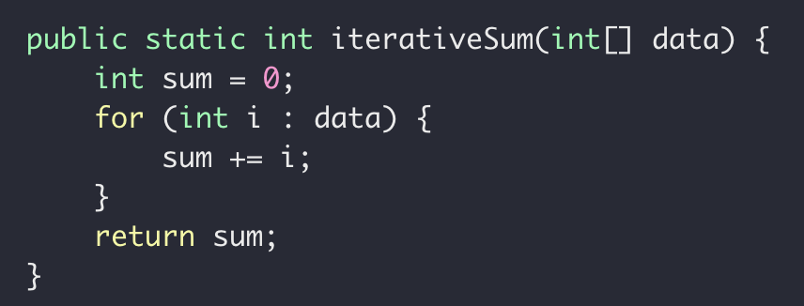
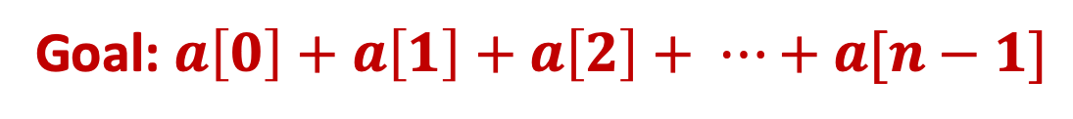
Recursive Sum
Goal: $a\left[0\right]+a\left[1\right]+a\left[2\right]+ ⋯+a[n−1]$
Iteratively

Slide 19
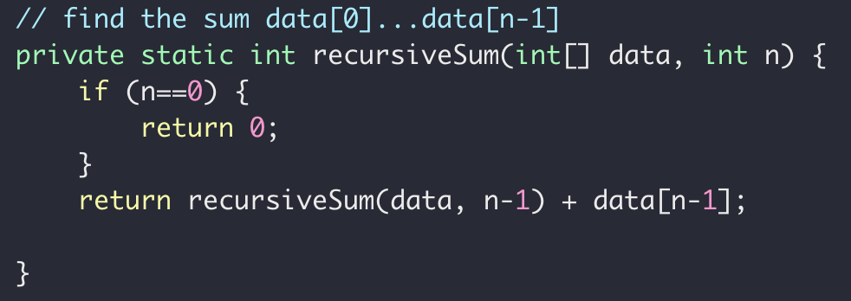
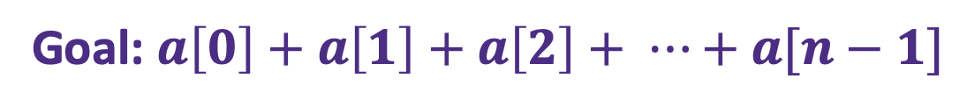


Recursive Sum
Goal: $a\left[0\right]+a\left[1\right]+a\left[2\right]+ ⋯+a[n−1]$
$sum\left(n\right)=a\left[0\right]+a\left[1\right]+ ⋯+a[n−2]+a[n−1]$
Problem
Sub-problem
$sum\left(n−1\right)=a\left[0\right]+a\left[1\right]+ ⋯+a[n−2]$
$sum\left(n−1\right)=a\left[0\right]+a\left[1\right]+ ⋯+a[n−2]$
$sum\left(n−1\right)= ?$
$sum\left(n\right)=sum(n−1)+a[n−1]$

Slide 20
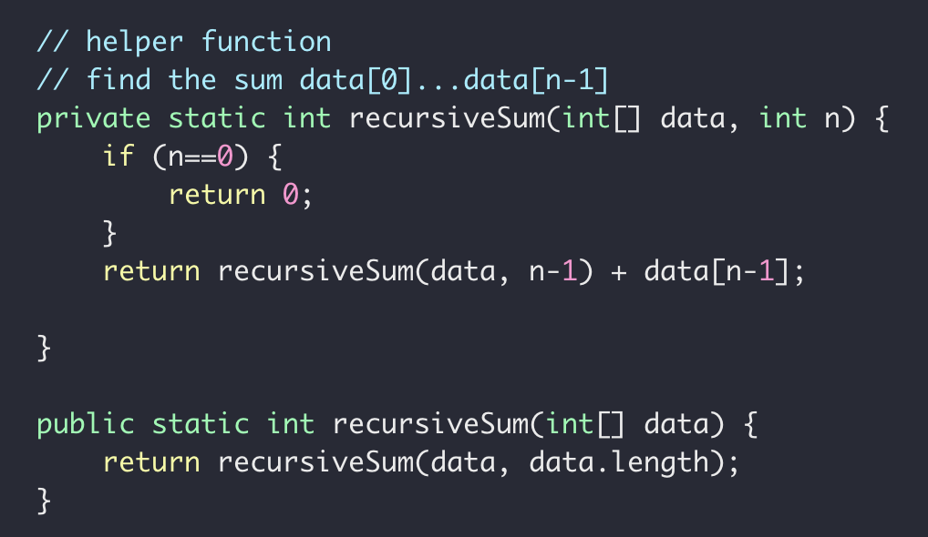
Recursive Sum
Goal: $a\left[0\right]+a\left[1\right]+a\left[2\right]+ ⋯+a[n−1]$

Slide 21




Recursive Sum
$$int \left[ \right] a=[5, 6,7,8]$$
Sum(data, 3)
Sum(data, 2)
$$=a\left[3\right]+$$
Sum(data, 1)
$$=a\left[2\right]+$$
Sum(data, 0)
$$=a\left[1\right]+$$

Slide 22





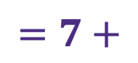
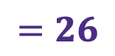
Recursive Sum
$$int \left[ \right] a=[5, 6,7,8]$$
Sum(data, 3)
$$=26$$
Sum(data, 2)
$$=8+$$
$$18$$
Sum(data, 1)
$$=7+$$
$$11$$
Sum(data, 0)
$$=6+$$
$$5$$

Slide 23
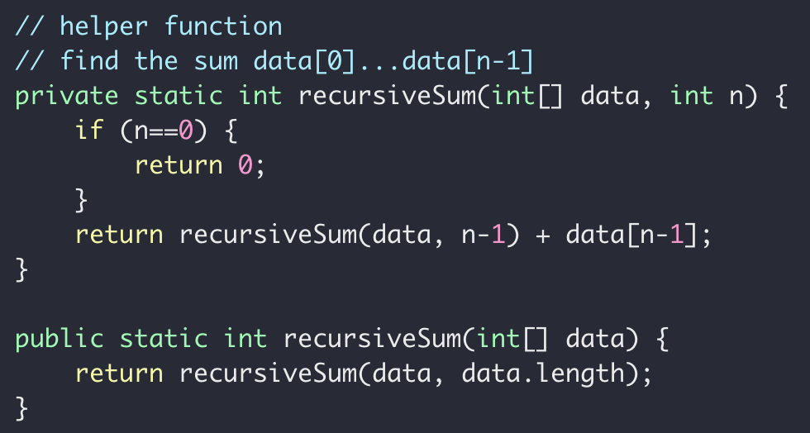
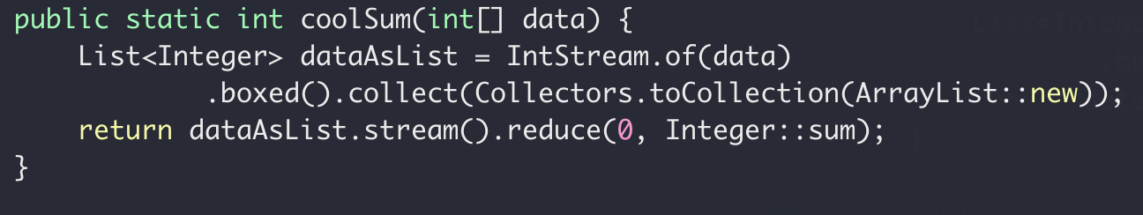
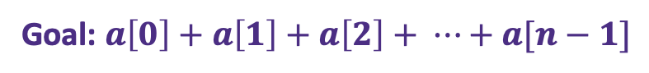
Recursive Sum
Goal: $a\left[0\right]+a\left[1\right]+a\left[2\right]+ ⋯+a[n−1]$
iterative
recursive
“modern”

Slide 24


Recursive Sum
Goal: $a\left[0\right]+a\left[1\right]+a\left[2\right]+ ⋯+a[n−1]$
Sum(data, n)
Sum(data, n-1)
$$=a\left[n−1\right]+$$
$sum\left(n\right)=a\left[n−1\right]+sum(n−1)$

Slide 25
Recursive findMax
Write a function to get the maximum of an int array
12
12
1
7
18
18
10
3
0
1
2
3
4
5
6

Slide 26
Recursion
How to find the largest apple
In box 0 to 5
0
1
2
3
4
5
Largest apple:
1
1
0

Slide 27
Recursion
How to find the largest apple
In box 0 to 5 (noted as [0,5])
Get the first apple from [0,5]
Find the largest apple from [1,5]
compare it with apple 0
0
1
2
3
4
5

Slide 28
Recursion
How to find the largest apple
In box 1 to 5
Get the first apple from [1,5]
Find the largest apple from 2-5
compare it with apple 1
0
1
2
3
4
5

Slide 29
Recursion
How to find the largest apple
In box 2 to 5
Get the first apple from [2,5]
Find the largest apple from 3-5
compare it with apple 2
0
1
2
3
4
5

Slide 30
Recursion
How to find the largest apple
In box 1 to 5
Get the first apple from [3,5]
Find the largest apple from 3-5
compare it with apple 3
0
1
2
3
4
5

Slide 31
Recursion
How to find the largest apple
In box 1 to 5
Get the first apple from [4,5]
Find the largest apple from 4-5
compare it with apple 4
0
1
2
3
4
5

Slide 32
Recursion
How to find the largest apple
In box 1 to 5
Only 1 apple is left, it’s the largest comparing to itself
0
1
2
3
4
5

Slide 33
Recursion
How to find the largest apple
In box 1 to 5
Get the first apple from [4,5]
Find the largest apple from 4-5
compare it with apple 4
0
1
2
3
4
5

Slide 34
Recursion
How to find the largest apple
In box 1 to 5
Get the first apple from [4,5]
Find the largest apple from 4-5
compare it with apple 4
0
1
2
3
4
5

Slide 35
Recursion
How to find the largest apple
In box 1 to 5
Get the first apple from [3,5]
Find the largest apple from 3-5
compare it with apple 3
0
1
2
3
4
5

Slide 36
Recursion
How to find the largest apple
In box 1 to 5
Get the first apple from [3,5]
Find the largest apple from 3-5
compare it with apple 3
0
1
2
3
4
5

Slide 37
Recursion
How to find the largest apple
In box 2 to 5
Get the first apple from [2,5]
Find the largest apple from 3-5
compare it with apple 2
0
1
2
3
4
5

Slide 38
Recursion
How to find the largest apple
In box 1 to 5
Get the first apple from [1,5]
Find the largest apple from 2-5
compare it with apple 1
0
1
2
3
4
5

Slide 39
Recursion
How to find the largest apple
In box 1 to 5
Get the first apple from [1,5]
Find the largest apple from 2-5
compare it with apple 1
0
1
2
3
4
5

Slide 40
Recursion
How to find the largest apple
In box 1 to 5
Get the first apple from [1,5]
Find the largest apple from 2-5
compare it with apple 1
0
1
2
3
4
5

Slide 41
Recursion
How to find the largest apple
In box 0 to 5 (noted as [0,5])
Get the first apple from [0,5]
Find the largest apple from [1,5]
compare it with apple 0
0
1
2
3
4
5

Slide 42
Recursion
How to find the largest apple
In box 0 to 5 (noted as [0,5])
Get the first apple from [0,5]
Find the largest apple from [1,5]
compare it with apple 0
0
1
2
3
4
5

Slide 43
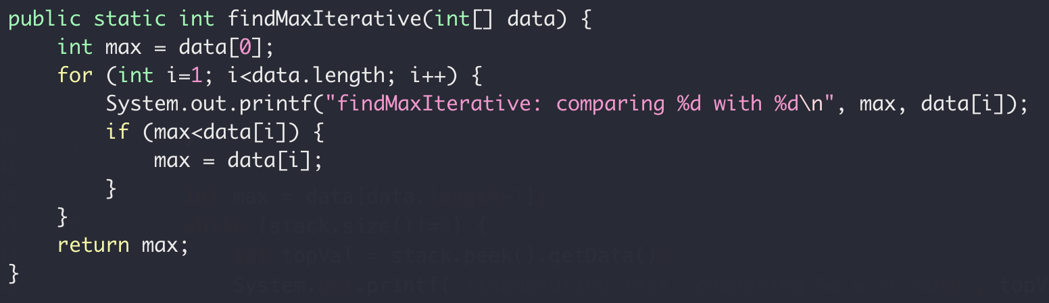
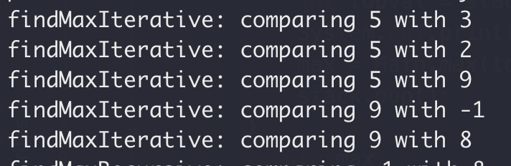
Recursive Max
Iteratively
5
3
2
9
-1
8
0
1
2
3
4
5

Slide 44
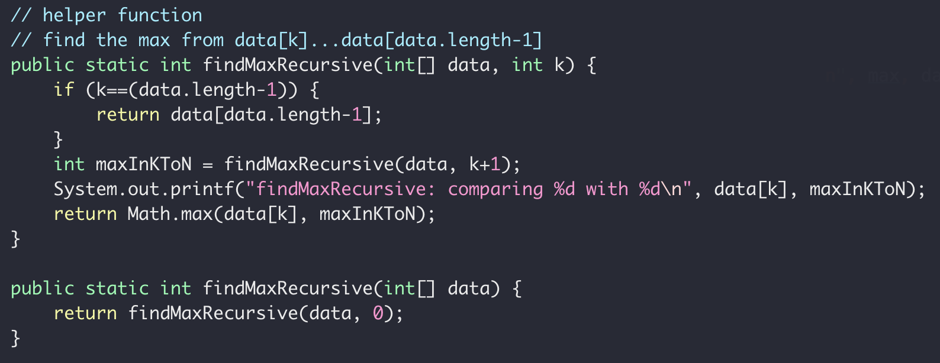
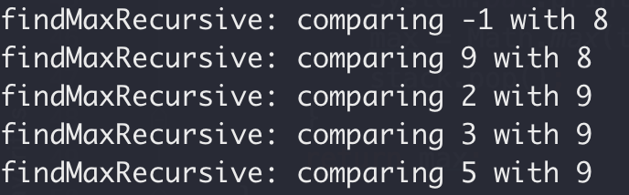
Recursive Max
5
3
2
9
-1
8
0
1
2
3
4
5
Recursively

Slide 45
Recursion
How it works
When to use it

Slide 46
”guess them all”
?
?
?
A gift in one of the box

Slide 47
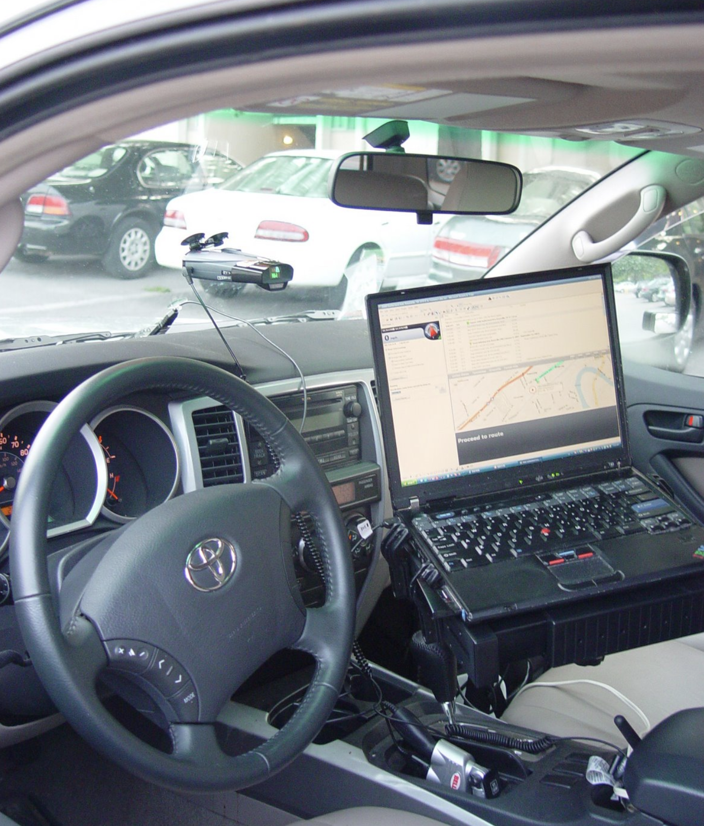
Backtracking
Kayaking trip
Fontana Lake, 07/03/2007

Slide 48
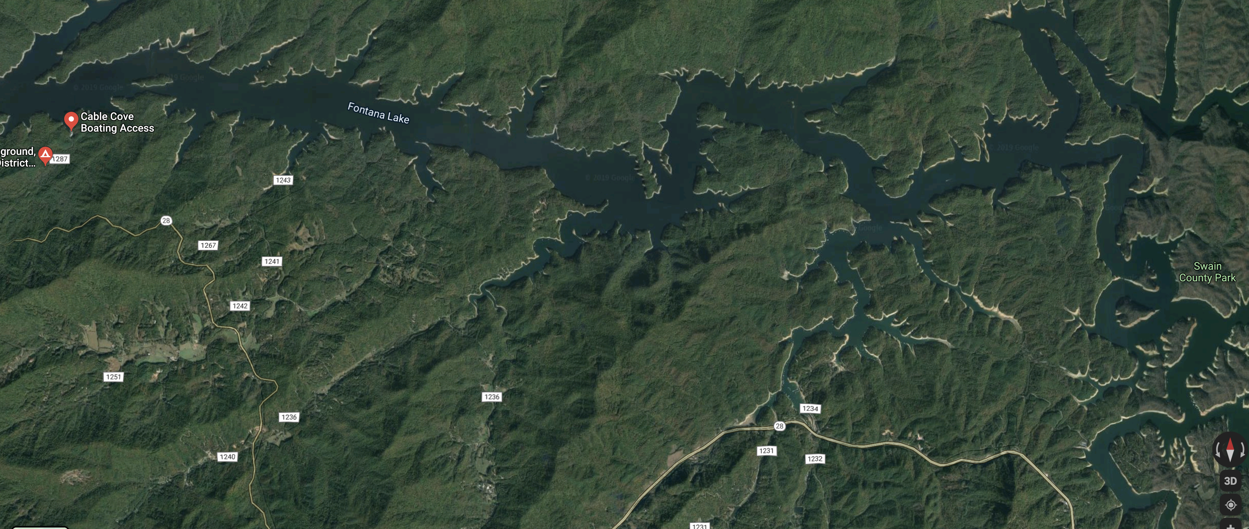
Backtracking

Slide 49
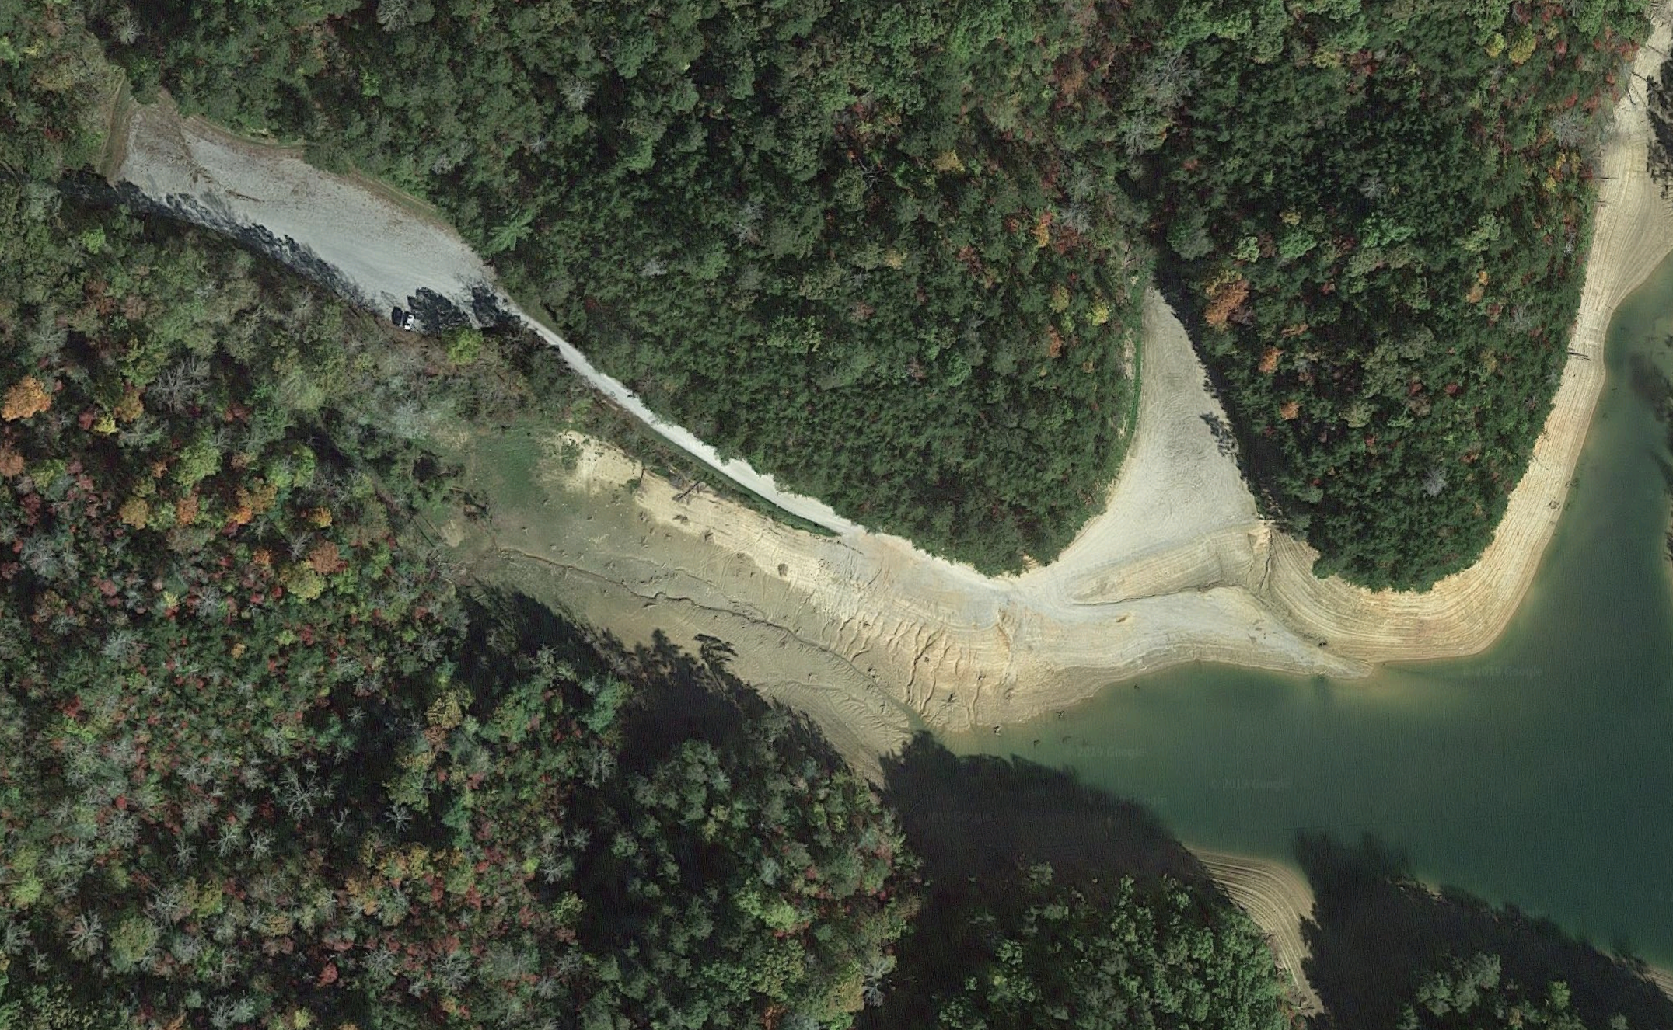
Backtracking

Slide 50

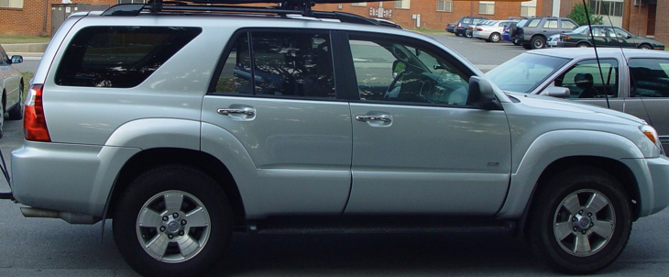
Backtracking

Slide 51


Backtracking

Slide 52
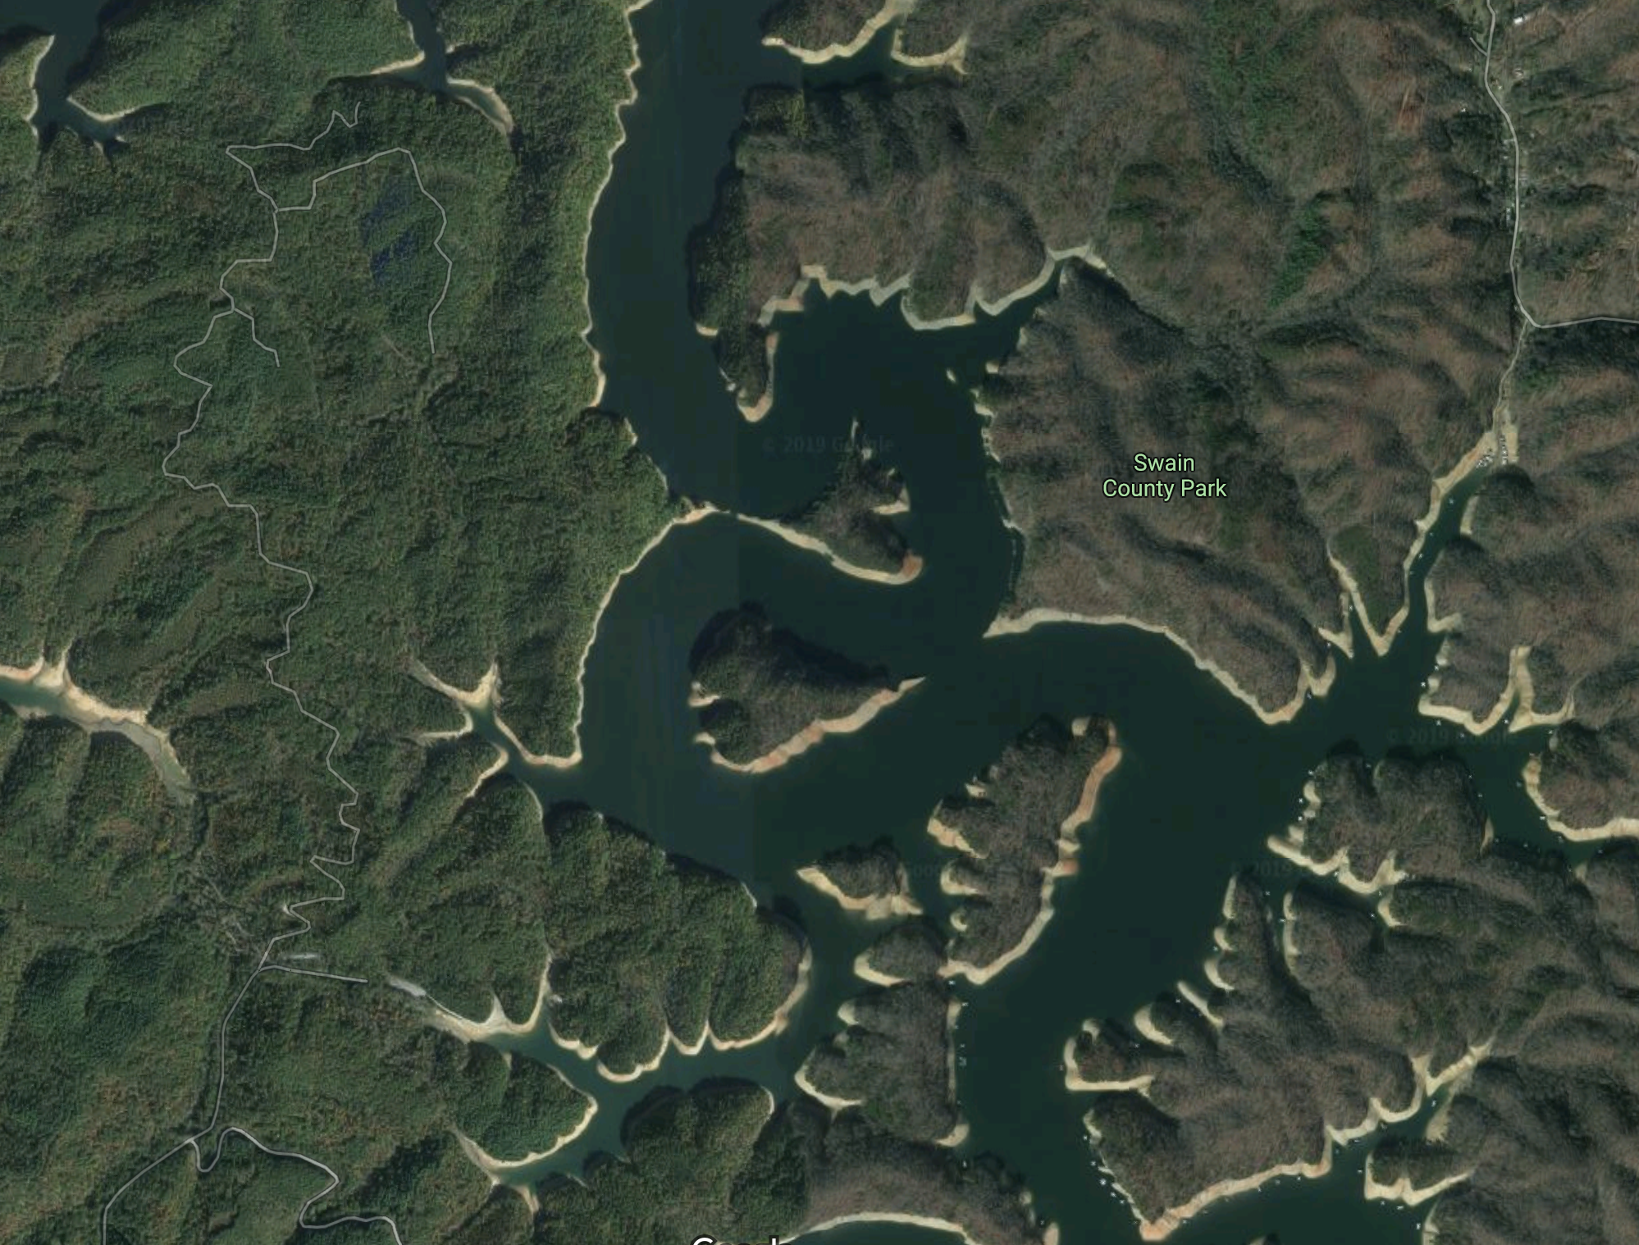



Backtracking

Slide 53
Backtracking
Move forward if there’s only one possible path
When there’s a fork, go with one of paths
If it too far, return (backtrack) to the fork, and try the other paths

Slide 54
Backtracking

Slide 55
Backtracking
TOO FAR!

Slide 56
Backtracking
NOP!

Slide 57

Backtracking

Slide 58

Backtracking trip
When in doubt, keep calm and backtrack!

Slide 59
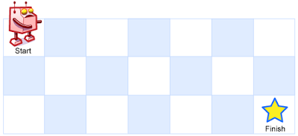


Recursion In Class Exercise: Unique Paths
A robot is located at the top-left corner of a grid
The robot can only move either down or right at any point in time.
How many possible unique paths are there?
$m$ rows
$n$ columns

Slide 60
Recursion In Class Exercise: Unique Paths
A robot is located at the top-left corner of a grid
The robot can only move either down or right at any point in time.
$m$ rows
$n$ columns

Slide 61
Recursion In Class Exercise: Unique Paths
A robot is located at the top-left corner of a grid
The robot can only move either down or right at any point in time.
$m$ rows
$n$ columns

Slide 62
Unique Paths
1
1
1
1
2
1

Slide 63
Unique Paths
1
1
1
1
1
1
2
3
4
5
1
3
6
10
15

Slide 64
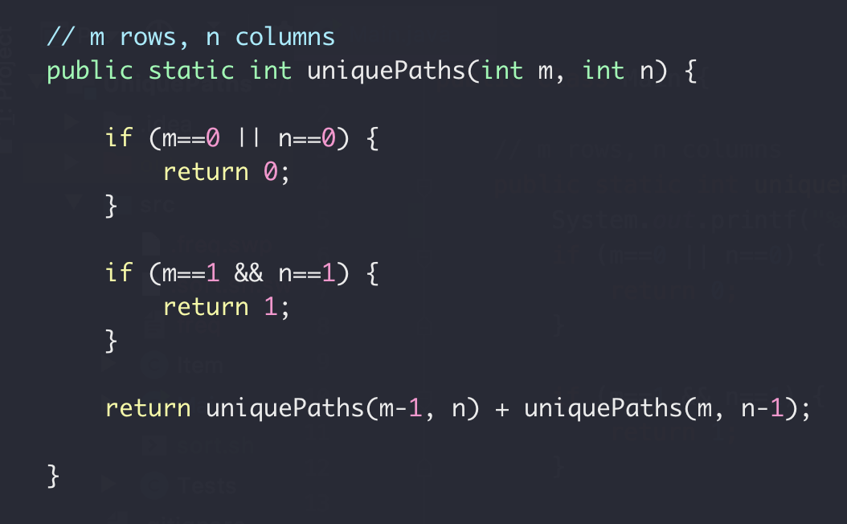
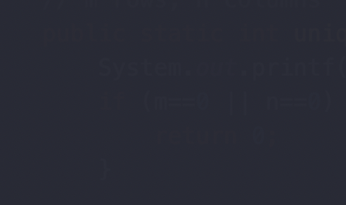

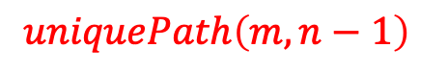
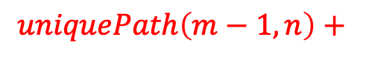


Unique Paths
1
1
1
1
1
$m$ rows
1
2
3
4
3
4
$$uniquePath\left(m, n\right)=$$
$n$ columns
$$uniquePath\left(m−1, n\right)+$$
$$uniquePath\left(m, n−1\right)$$

Slide 65
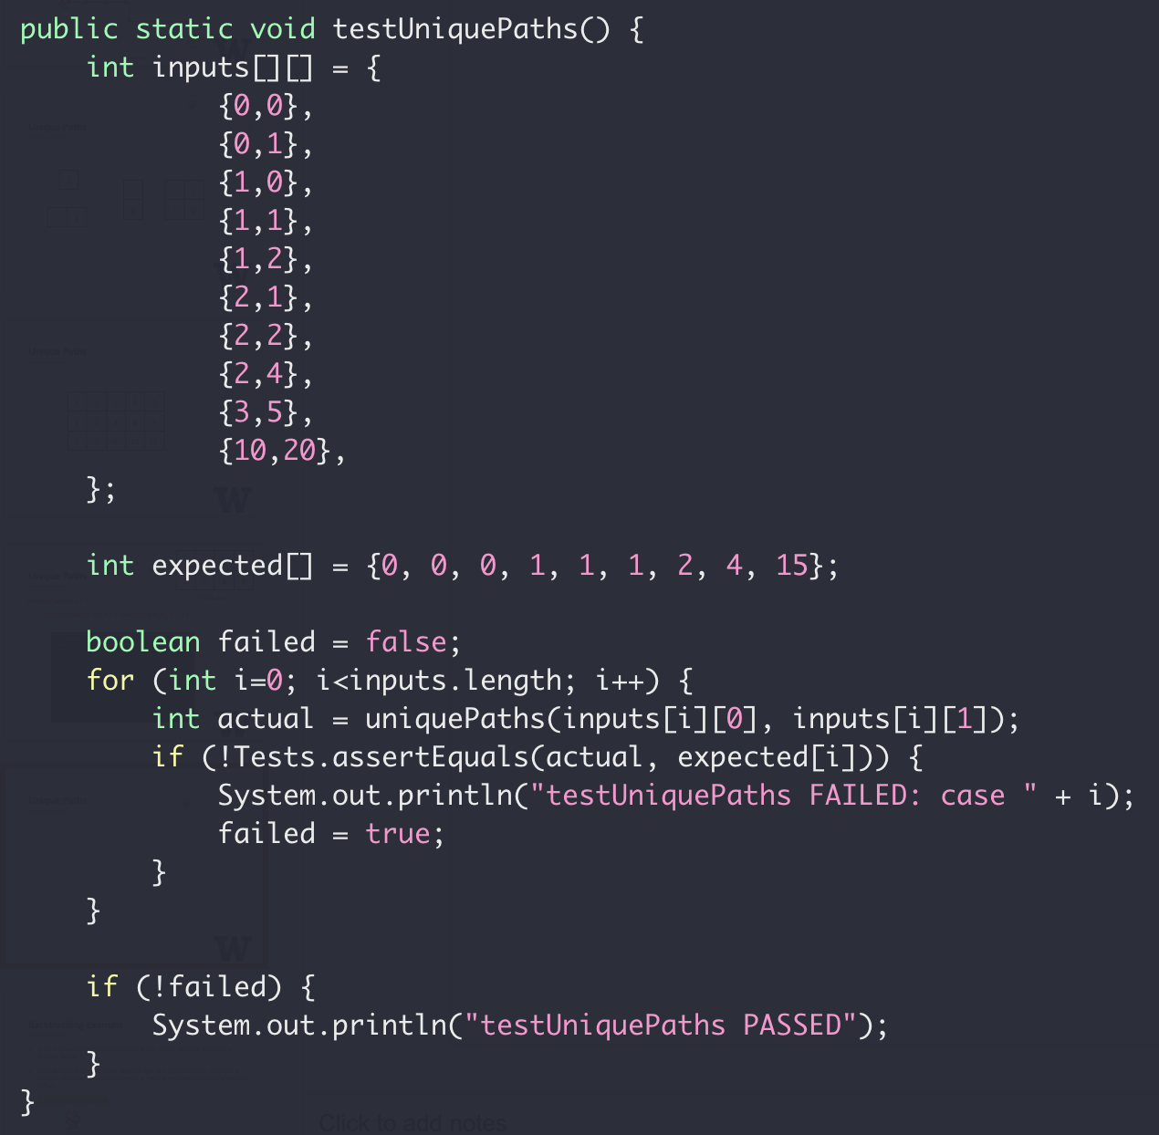
Unique Paths Tests

Slide 66
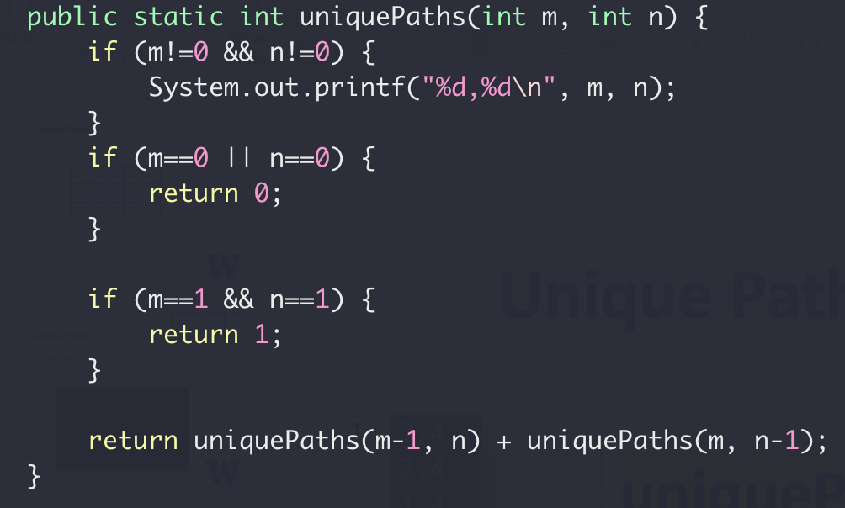

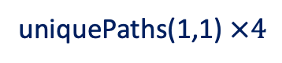

Unique Paths Tests
uniquePaths(3,4)
1
2
3
4
3,4
2,4
1,4
1,3
1,2
1,1
1
2,3
1,3
1,2
1,1
2
$m$ rows
2,2
1,2
1,1
2,1
1,1
3
$n$ columns
uniquePaths(1,1) $×4$

Slide 67
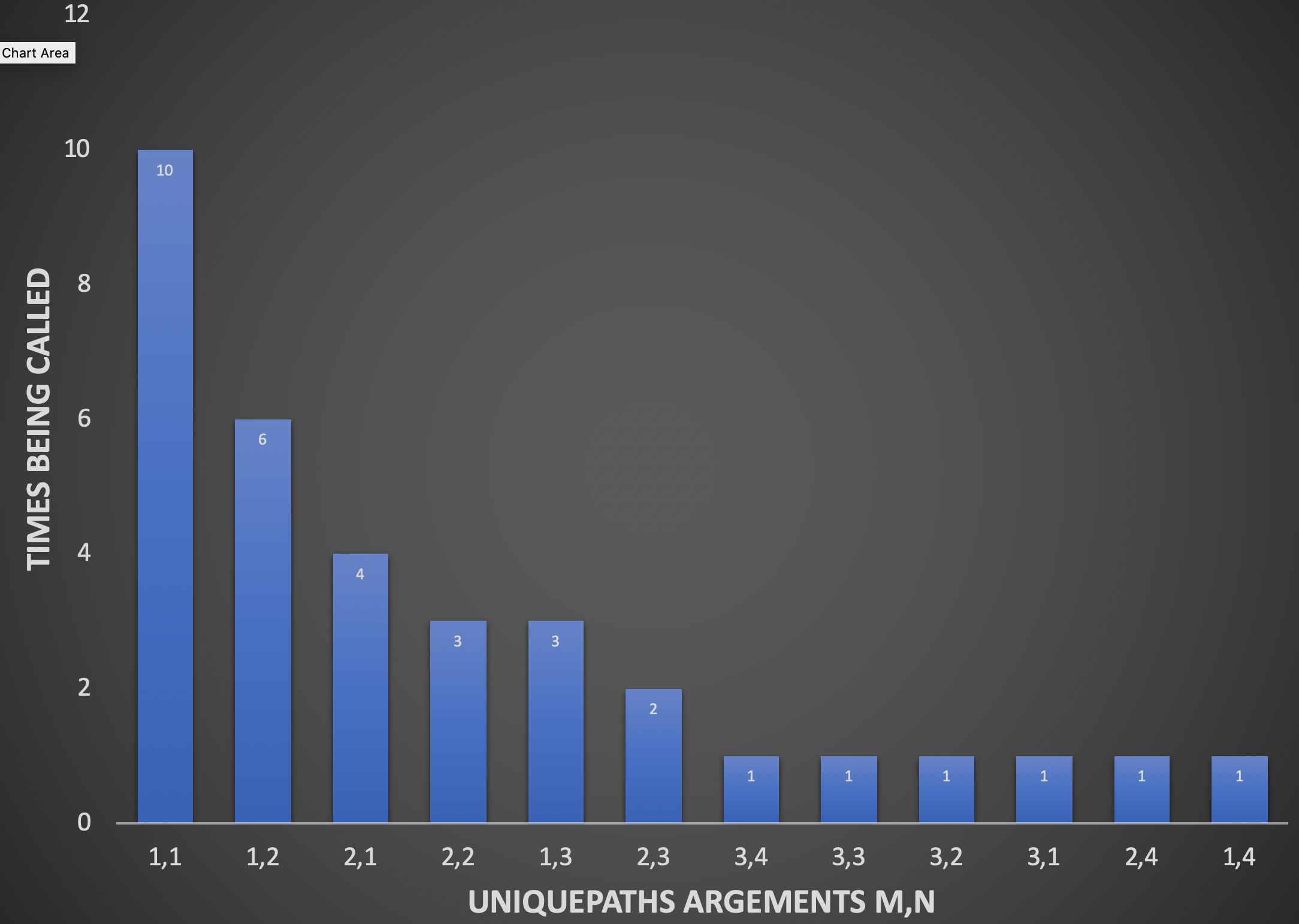

Unique Paths Tests
uniquePaths(3,4)

Slide 68
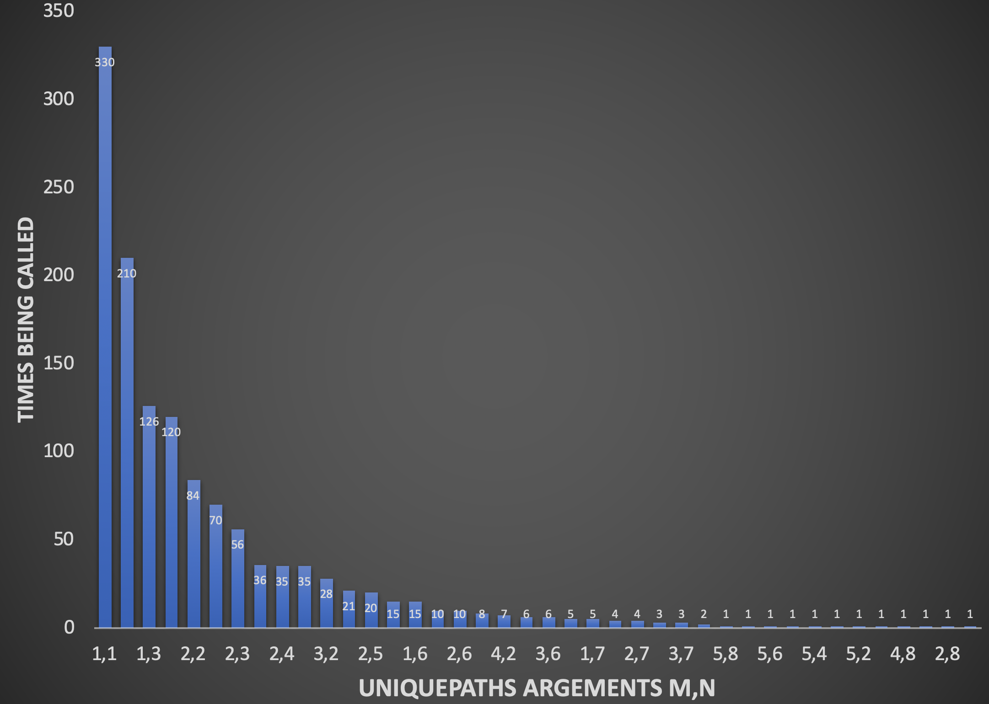
Unique Paths Tests
uniquePaths(5,8)

Slide 69
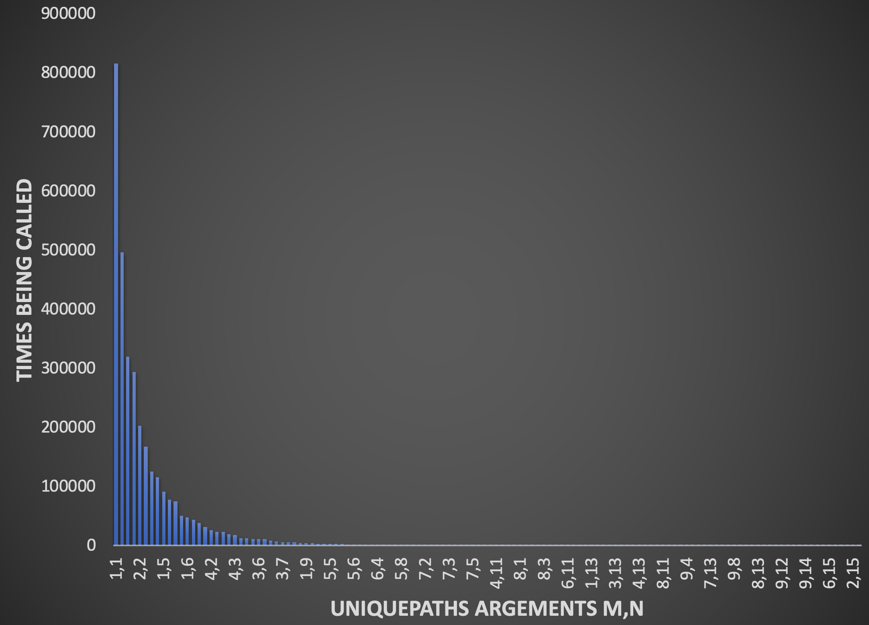
Unique Paths Tests
uniquePaths(10,15)
Repeated subproblem

Slide 70
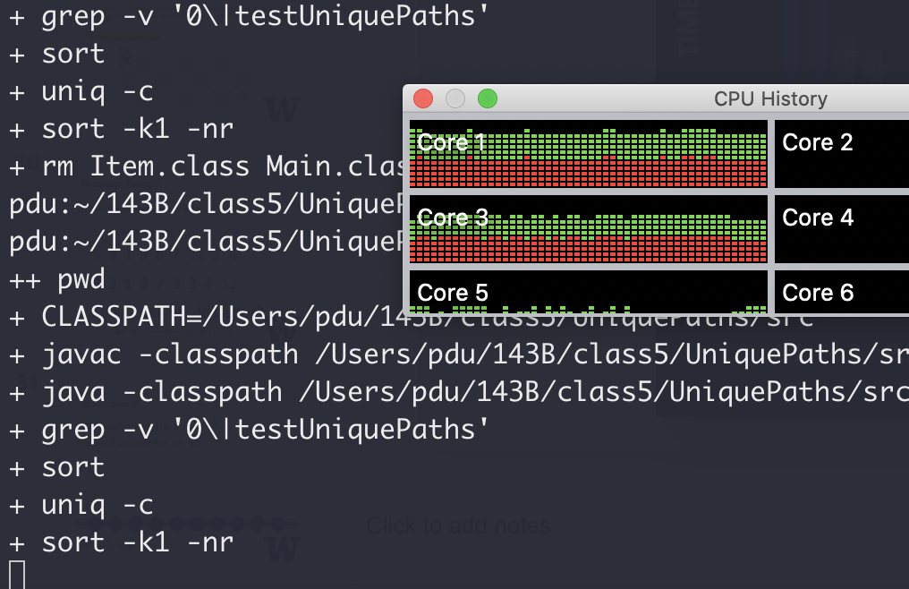

Unique Paths Tests
uniquePaths(20,30)
Dude it’s been 30 minutes…

Slide 71
Unique Paths
Repeated subproblems
1
1
1
1
1
1
2
3
4
5
recursion
1
3
6
10
15

Slide 72
Unique Paths
Repeated subproblems
1
1
1
1
1
1
2
3
4
5
1
3
6
10
15
Dynamic programming FTW

Slide 73
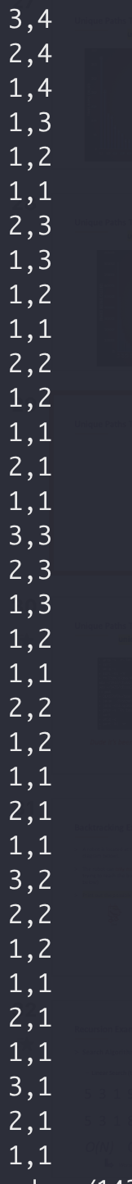
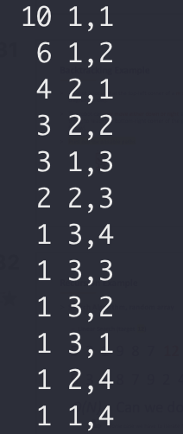
Unique Paths Tests

Slide 74

Where’s the code?
https://github.com/pdgetrf/recursion-examples

Slide 75

Recursion
“you never really remember
the beginning of a dream, do you?”
$−$ Inception

